Slide 1


SMART INDIA HACKATHON 2024
Problem Statement ID - 12
Problem Statement title - Identification Of Algorithm From The Given Dataset Using AI/ML Technique
Theme - BlockChain & CyberSecurity
PS Category - Software
PS ID - SIH1681
Team Name - Tech Innovators

Slide 2
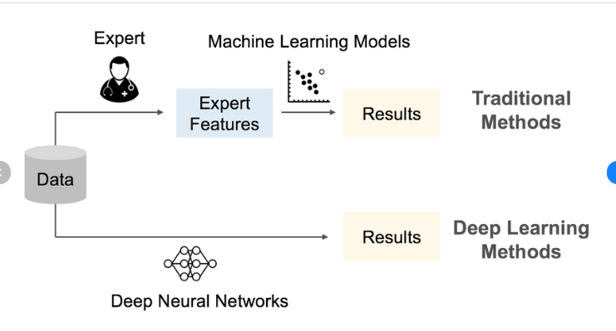
Automated Algorithm Selection for Optimal Performance on Structured Datasets Using AI/ML Techniques
Description :
Selecting the right machine learning model for a dataset is a time-consuming and complex task, with performance varying across algorithms like Random Forest, SVM, and neural networks. Manually testing each model is inefficient, especially with large datasets.
This project aims to solve this by creating a Model Selection Tool that automatically compares traditional machine learning models with neural networks, helping users identify the best-performing model quickly and accurately based on dataset-specific metrics.
Proposed Solution : The solution is a model selection tool that compares traditional machine learning algorithms (Random Forest, SVM) with a neural network to identify the best-performing model for a given dataset.
+
Detailed Explanation : 1. Data Loading & Preprocessing : Load the dataset and preprocess 2. Model Training : Train both traditional ML models and a neural network. 3. Evaluation : Compare performance using metrics like accuracy & MAE 4. Best Model Selection : selects the model with highest accuracy or lowest error based on the dataset type.
How It Addresses the Problem : This tool solves the challenge of selecting the right algorithm for a dataset by automatically testing and comparing models, saving time and improving prediction accuracy. Innovation and Uniqueness : The uniqueness lies in its ability to handle structured data.

Slide 3
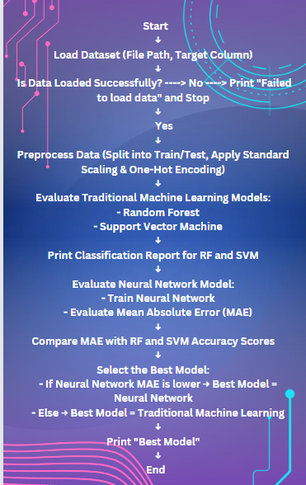
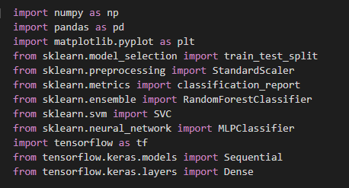
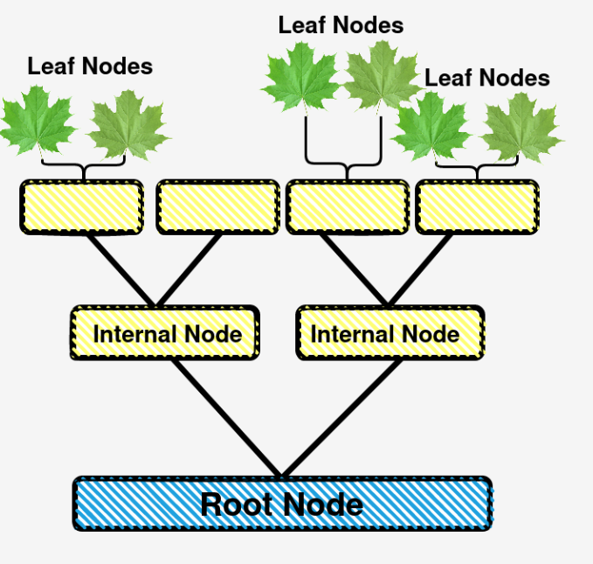
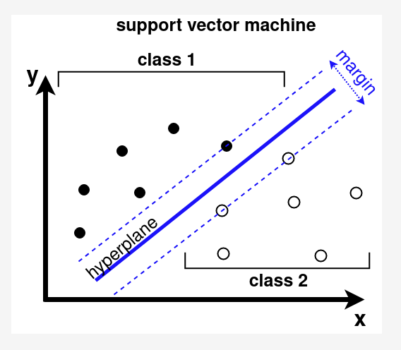
TECHNICAL APPROACH
Project Flow :
Python Framework :
Decision Tree :
Support Vector Machine :

Slide 4
FEASIBILITY AND VIABILITY
1. Feasibility
Traditional Models (e.g., Linear Regression, Decision Trees) :
Feasibility : Traditional models are generally more feasible to implement in simpler applications with small datasets and less complex relationships. They require less computational power and are interpretable.
Neural Networks :
Feasibility : Neural networks, especially deep learning models, are feasible for applications involving large datasets and complex patterns such as image recognition, natural language processing, or AI-driven automation. However, they require more expertise to develop and maintain.
2. Viability
Traditional Models :
Viability : Traditional models remain viable for use cases where interpretability, simplicity, and low resource consumption are critical. They are effective for tasks with well-understood mathematical relationships and can generalize well on modest datasets.
Speed : Typically faster to train and deploy, with lower infrastructure costs, making them viable for real-time applications or in environments where processing power is limited.
Neural Networks :
Viability : Neural networks are increasingly viable for modern applications where accuracy and the ability to model complex relationships are crucial, such as in autonomous systems, recommendation engines, and real-time language translation.
Explainability : One limitation is their "black-box" nature, making them less interpretable than traditional models, which can hinder their viability in highly regulated industries that demand transparency.

Slide 5
IMPACT AND BENEFITS
Traditional Models (E.g : Linear Regression, Decision Trees) :
Benefits :
Simplicity : Easier to interpret and implement.
Low Computational Power : Require fewer resources and training time.
Better for Small Data : Perform well with structured, smaller datasets.
Interpretability : Clear mathematical foundations, making results more explainable.
Impact :
Effective in solving simple, well-understood problems.
Useful in areas like financial analysis, where interpretability is key.
Neural Networks (E.g : CNNs, DNN, RNNs ):
Benefits :
Powerful for Complex Problems : Handle large and unstructured data like images, audio, and text.
Feature Learning : Automatically extract features, reducing manual effort.
Adaptability : Suitable for a wide range of tasks, from classification to generative models.
Scalability : Excel with large datasets and can continuously improve as data grows.
Impact :
Transformed fields like image recognition, natural language processing, and autonomous systems.
Enabled advances in AI, deep learning, and applications like self-driving cars and virtual assistants

Slide 6
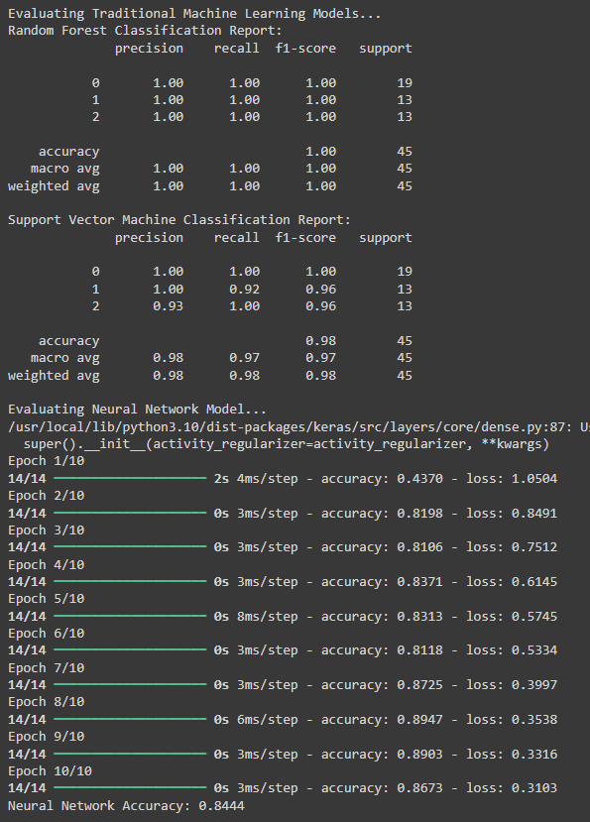
RESEARCH AND REFERENCES
Outcome :
Reference Link :
https://github.com/webcreatorsri/project.git

